Slide 1
Marketing Your Self and your Profession
Scott Arceneaux LAT, ATC
Director of Sports Medicine St Amant High School
President of the Louisiana Athletic Trainers' Assiocation

Slide 2
Who is going to Carry your Flag ?

Slide 3
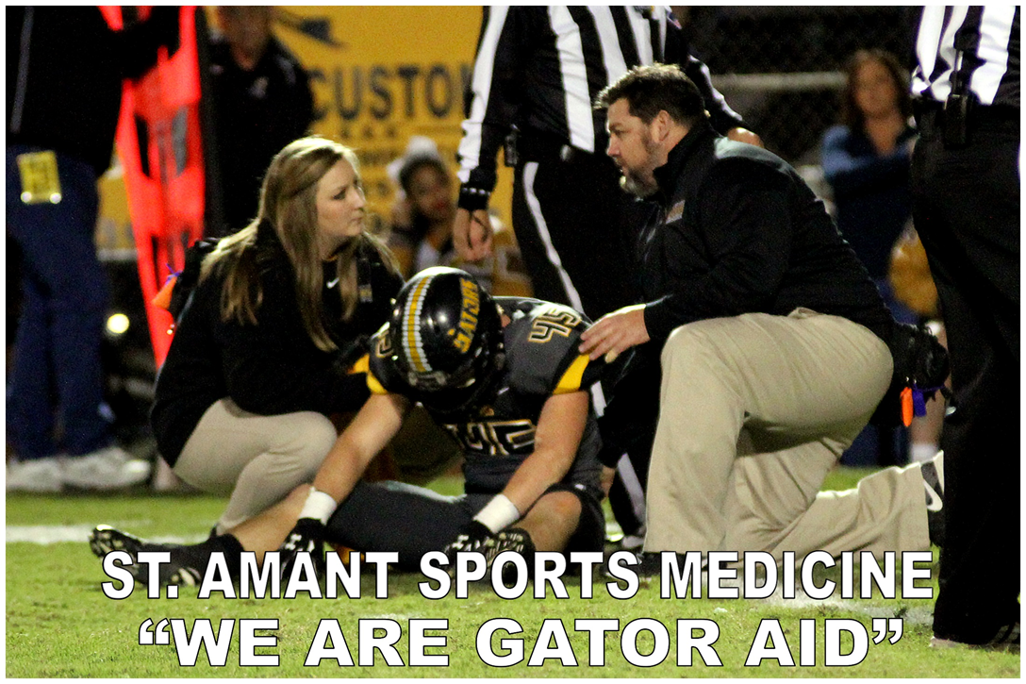
“We are an extension of the medical community , Not the coaching staff”

Slide 4
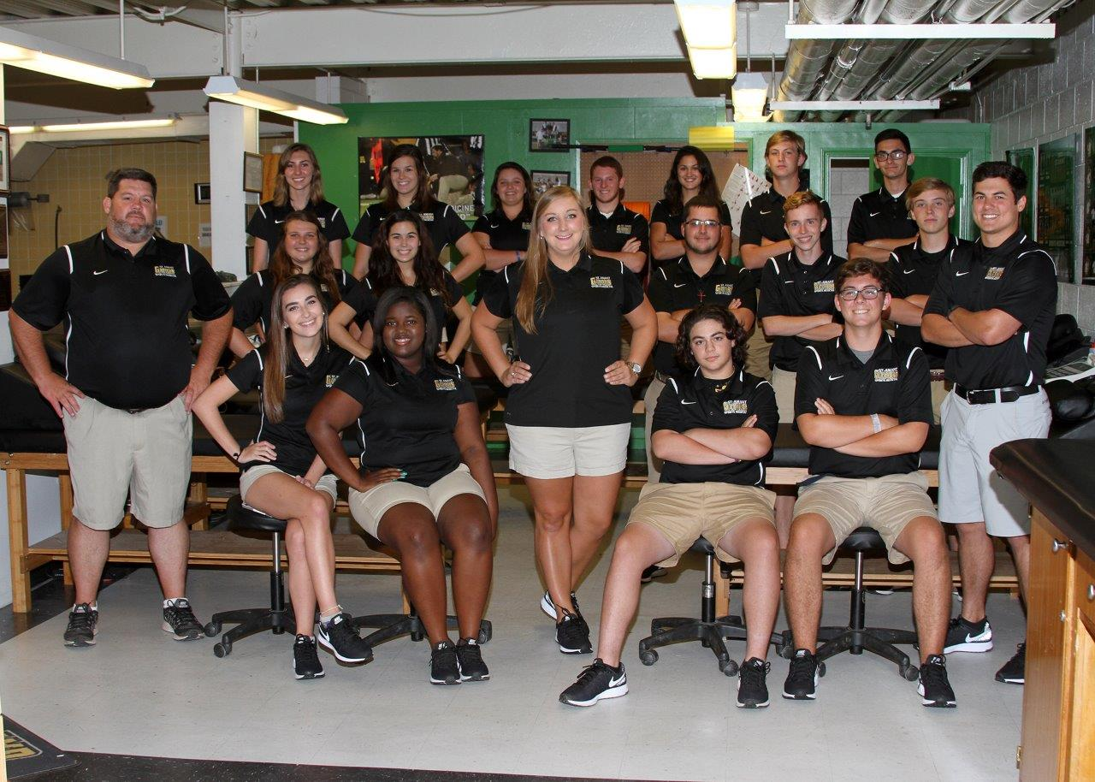
Professionalism
“Know your role”

Slide 5
Being an Effective Marketer
Effective Marketing rule #1 tell people your WHY. Why are you doing what you do and what is the ultimate purpose.
Effective Marketers Are Storytellers - Top marketers know how to connect the dots by using narrative to set the quickly get people’s attention
Effective Marketers Build Relationships - Here is the definition of relationship from Wikipedia: “Relationships usually involve some level of interdependence. People in a relationship tend to influence each other, share their thoughts and feelings, and engage in activities together. Because of this interdependence, most things that change or impact one member of the relationship will have some level of impact on the other member.”
So a relationship can impact one another mentally, physically and emotionally.

Slide 6
Effective Marketers Are Givers - People often forget that trust is earned over time typically on a more intimate level. In order to introduce your great product or services, you need to earn the right to ask for the sell.
Effective Marketers Know Everything Is A Test - There is no silver bullet that will bring you sustainable instant results. In fact, it’s vital to have the right mindset knowing that every action you take is to validate your ideas from fact gathering.
Great marketers do not hold their ego to their chest; they look for facts and data that enable them to make incremental improvements.
Effective Marketers Are Laser Focused On A Niche - Since people aren’t good at valuing anything with out learning, top marketers knows to create techniques or systems that enable the prospects to understand the value of the solution

Slide 7
The 3 P’s
People
Professionalism
Policy and Procedure

Slide 8
3 year plan
Program Design
Budget
Marketing and Fundraising

Slide 9
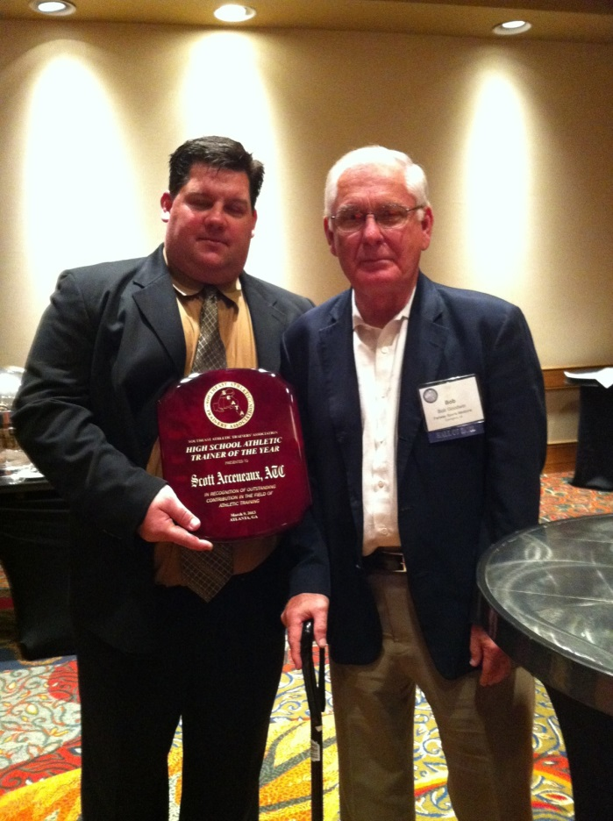
Thank You
Scott.Arceneaux@APSB.org
Latapresident@gmail.com

